Slide 1
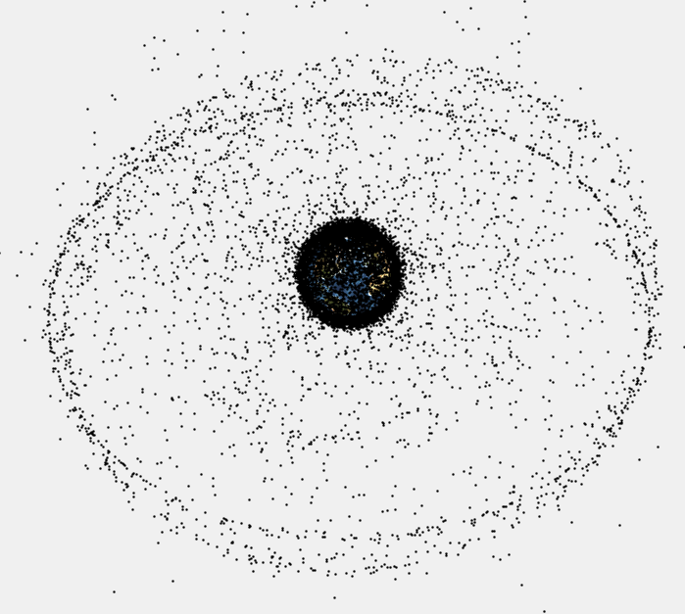
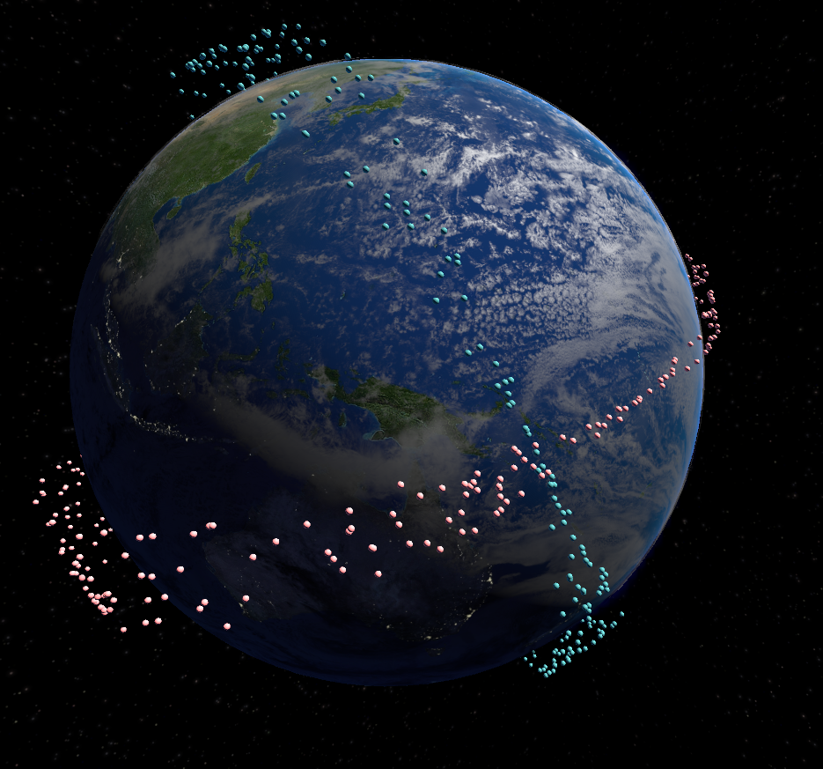
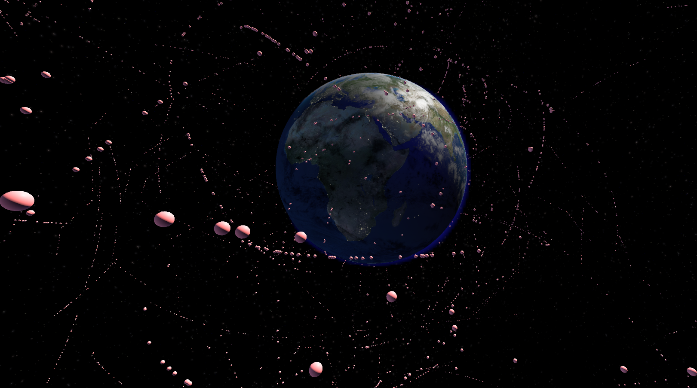

VISUALISATION OF ORBITAL OBJECT UNCERTAINTY USING GENERATIVE PARTICLE METHODS
Joel Stuart & Marcus Gallagher
BACKGROUND
The space around Earth has been increasingly congested with man-made debris. (Fig 1)
This debris consists of defunct spacecraft, mission-related debris and the fragmentation debris created when existing debris collides. Fragmentation debris numbers make up the largest share of the debris, and is expected to further inflate as more man-made debris is created with which existing debris may collide.
Due to the speeds space debris travels at, even tiny fragments of paint can cause significant damage to operational satellites. [2]
Thus the ability to predict current and future locations of all orbital objects is imperative to effective space missions. This area of study is known as Space Surveillance and Tracking (SST) and is a subsidiary of the broader field of Space Situational Awareness (SSA).
As of 2013, more than 500,000 fragments of space debris are tracked and catalogued [2], with millions more pieces too small to feasibly observe and catalogue.
RATIONALE
In response to existing literature [3,4], this project visualises and explores the non-Gaussian nature of observational orbital object uncertainty (OOOU), using a generated particle cloud to represent uncertainty contrary to the traditional Gaussian uncertainty volume (represented as a ellipsoid).
APPROACH
Using publicly available Two Line Element (TLE) catalogues of tracked space objects and existing free orbital object propagation model (SGP4), in conjunction with generative particle methods, a visualisation of OOOU was created.
Particles,${ p}^{r}$, are generated by adding a noise vector $φ^{r}$(modeling the error), to their initial state $x$, read from the TLE.
$p^{r} =x_{i}+φ^{r}$
All particles are then propagated forward in time using the SGP4 model.
RESULTS
Two main visualisation platforms were built: one within MATLAB, and another in Unity with HTC Vive VR support.
The MATLAB platform reads in TLE data, handles all the SGP4 propagation and either utilises the inbuilt plotting system or streams data via UDP to an instance of Unity.
Utilising GPU parallelisation methods, a laptop with an NVidia GPU was able to handle real-time visualisation of 60,000 simulated particles.
A companion software package was also written to perform close approach detection on the propagated datasets.
An interesting takeaway for the un-initiated is the importance of using recent TLE observations, as the certainty of object location quickly diverges, as can be seen in Fig 2.
CONCLUSIONS
Particle methods offer a novel alternative to traditional uncertainty volumes, but remain a significant computational challenge. Additional optimisations may be required to take full advantage of the produced visualisation.
REFERENCES
[1] - U.S. Congress, Office of Technology Assessment, “Orbiting Debris: A Space Environmental Problem-Background Paper”, (September 1990), OTA-BP-ISC-72, Washington, DC: U.S. Government Printing Office
[2] – NASA, Space Debris and Human Spacecraft, 2013, URL: http://www.nasa.gov/mission_pages/station/news/orbital_debris.html
[3] Hobson, T., Sensor Management for Enhanced Catalogue Management of Resident Space Objects, 2014, University of Queensland, p146.
[4] - G. Terejanu, P. Singlay, T. Singhz, P.D. Scottx, “Uncertainty Propagation for Nonlinear Dynamical Systems using Gaussian Mixture Models, (2008), American Institute of Aeronautics and Astronautics
[1]
Fig 1 - MATLAB Visualisation of TLE ‘Full’ Catalogue
(objects not to scale)
Fig 2 – Unity Visualisation of two outdated TLE observations with 400 particles per object..
Fig 3 – Unity Visualisation of Highly Elliptical Orbit (HEO) catalogue with 35 particles per object.

